Slide 1
Software Engineering
Prepared by: Neha Tripathi
Assistant Professor
Department of CSE
Graphic Era deemed to be University

Slide 2
What is Software Engineering
Software engineering is an engineering discipline that is concerned with all aspects of software production.
Engineering approach to develop software.
-A disciplined and systematic approach whose aim is the develop a quality software, software that is delivered on time, within budget, and that satisfies its requirements.
Systematic collection of past experience:
techniques,
methodologies,
guidelines.

Slide 3
Software Engineering Definition
The seminal definition:
[Software engineering is] the establishment and use of sound engineering principles in order to obtain economically software that is reliable and works efficiently on real machines.
The IEEE definition:
Software Engineering: (1) The application of a systematic, disciplined, quantifiable approach to the development, operation, and maintenance of software; that is, the application of engineering to software. (2) The study of approaches as in (1).

Slide 4
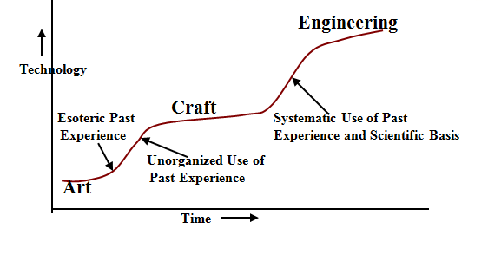
Technology Development Pattern

Slide 5
What is the difference between software engineering and computer science?
Computer science focuses on theory and fundamentals;
Software Engineering is concerned with the practicalities of developing and delivering useful software.

Slide 6
Why Study Software Engineering?
To acquire skills to develop large programs.
-Exponential growth in complexity and difficulty level with size.
-The ad hoc approach breaks down when size of software increases.
Ability to solve complex programming problems:
-How to break large projects into smaller and manageable parts?

Slide 7
What is Software?
The product that software professionals build and then support over the long term.
Software encompasses:
(1) instructions (computer programs) that when executed provide desired features, function, and performance;
(2) data structures that enable the programs to adequately store and manipulate information and
(3) documentation that describes the operation and use of the programs.
Thus, Software is a collection of computer programs, data structures and associated documentation.
Software products may be developed for a particular customer or may be developed for a general market.

Slide 8
Programs versus Software Products
?

Slide 9
Thank You!

